Slide 1

Secure QR Code Transmission Using Permutation Scrambling, Share Splitting, and Private Blockchain Channels Mentor : Dr. B. Thanasekhar
TEAM MEMBERS (A19):
Abhinavh P(2022503059)
Prabhakara Arjun R(2022503003)
Buvanes Srivardan K(2022503037)
1

Slide 2
Problem Statement
QR codes are widely utilized in various fields for quick and efficient information sharing. However, they are vulnerable to security threats such as information leakage, data tampering, and unauthorized access, especially during transmission and storage. Ensuring the confidentiality and integrity of QR code data in such scenarios is crucial to prevent misuse and maintain trust.
2

Slide 3
Objective
The primary objective of this project is to
Ensuring Secure Data Transmission with help of permutation scrambling , share splitting algorithm.
Enhancing Data Integrity and Decentralization with help of private blockchain.
3

Slide 4
Problems faced in QR Code Transmission System in Industries
Security threats
Lack of encryption
Single point of failure
No secure storage mechanism
4

Slide 5
Importance of our project
Enhanced security with encryption(AES) and scrambling.
Data confidentiality and share splitting(all shares is needed to reconstruct QR).
Decentralization and tamper resistant
5

Slide 6
Project modules
QR code generation and encryption.
Decryption and data retrieval.
Transmission and evaluation metrics.
6

Slide 7
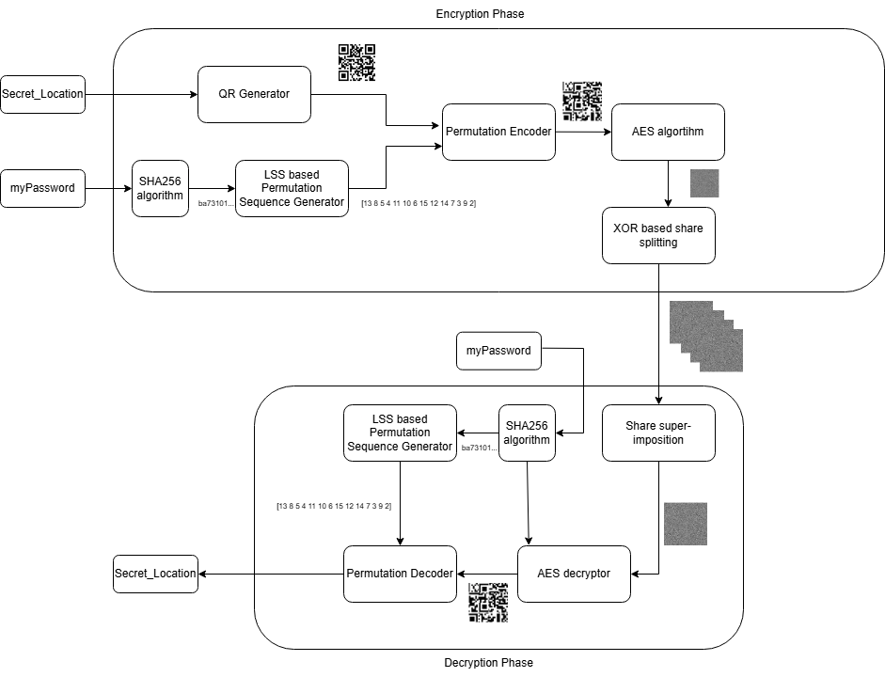
Architecture diagram
7

Slide 8
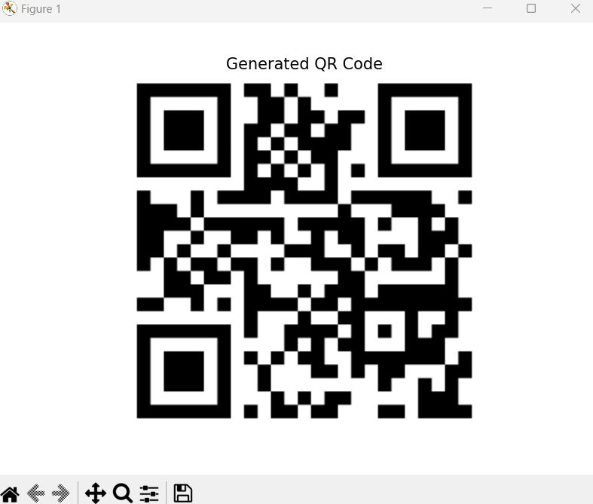
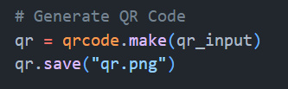

MODULE-1: QR code generation and encryption.
QR code generation
8

Slide 9
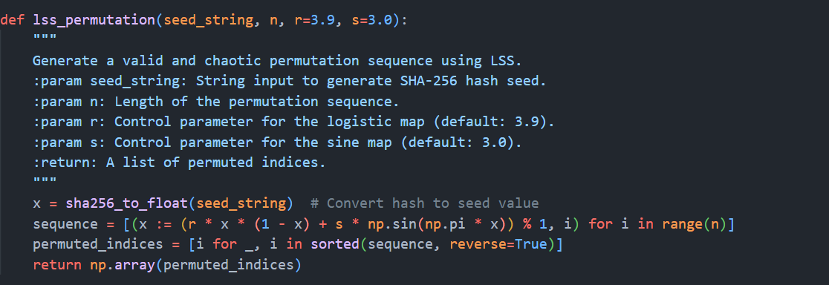
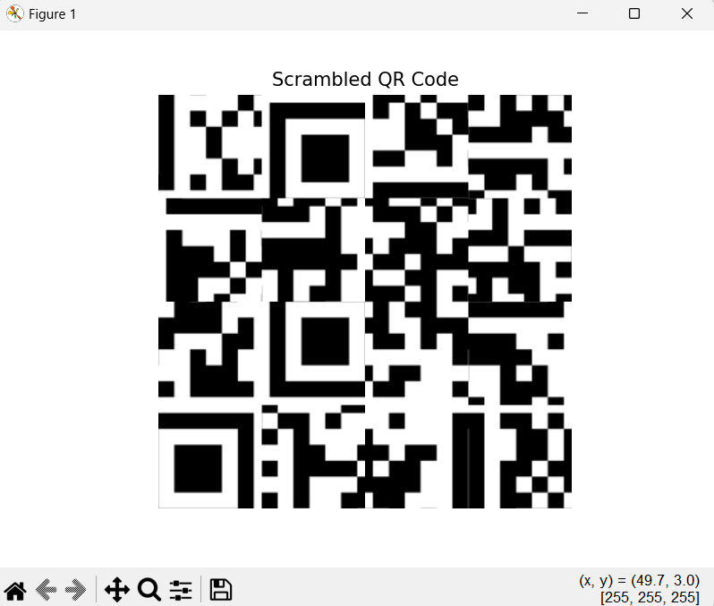
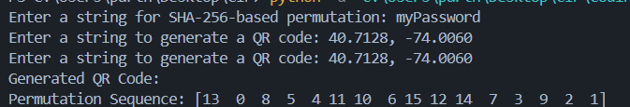
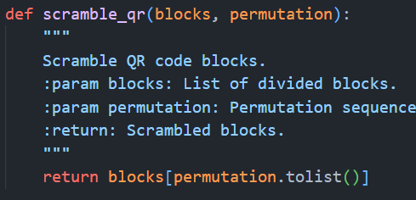
Permutation scrambling using LSS and sha256
9

Slide 10
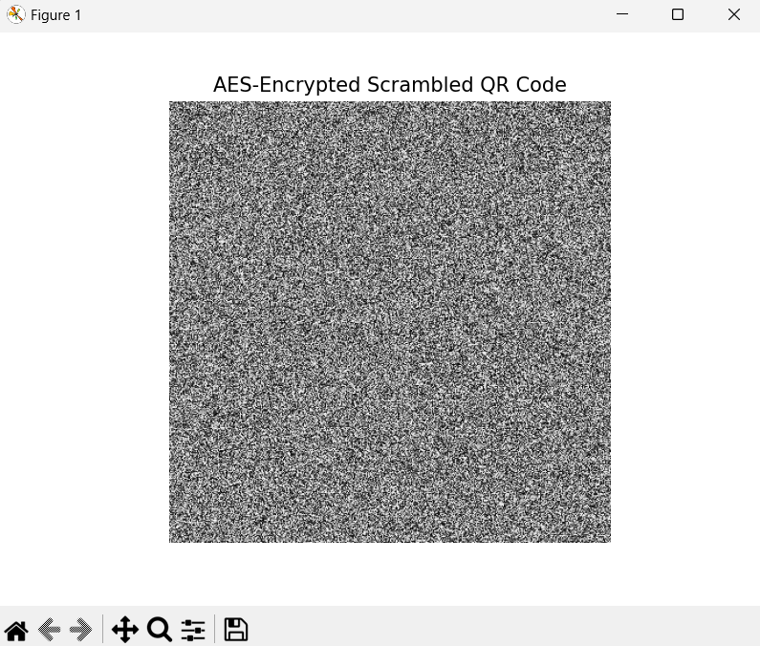
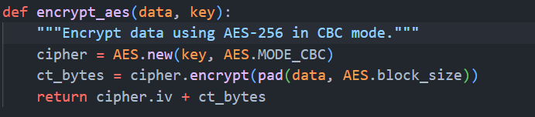
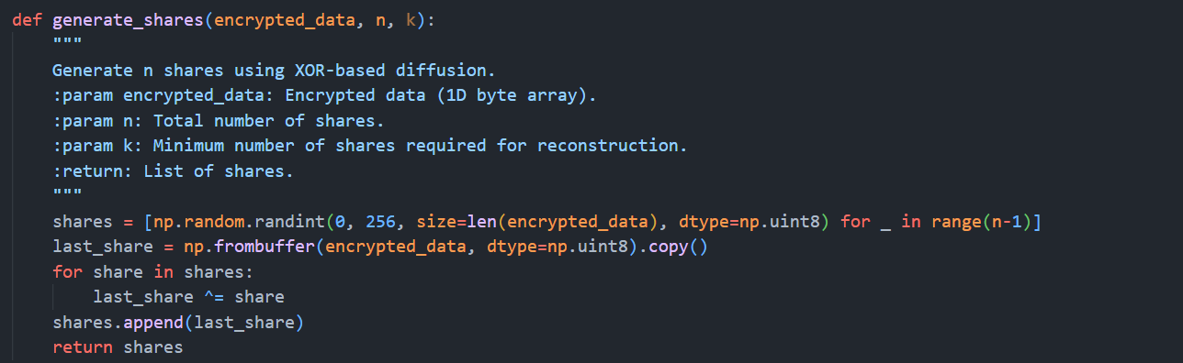
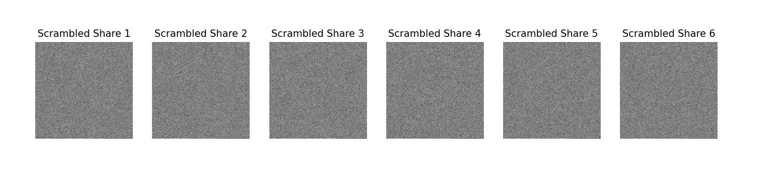
AES and XOR based share splitting algorithm
10

Slide 11
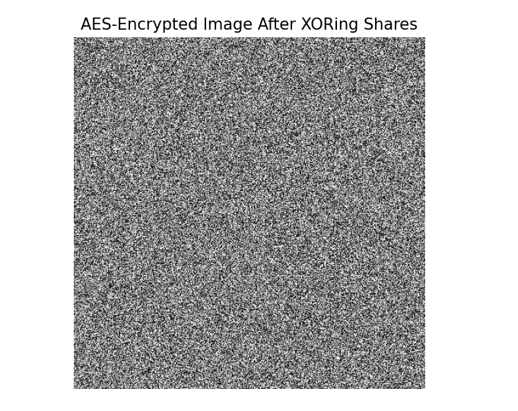
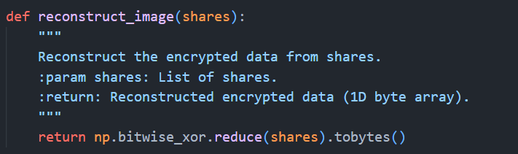
MODULE-2:Decryption and data retrieval.
XORing all the n shares to obtain AES image
11

Slide 12
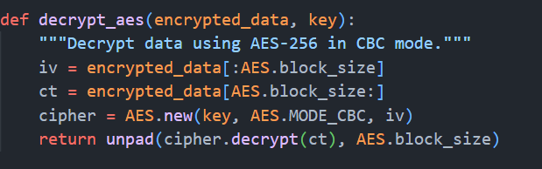
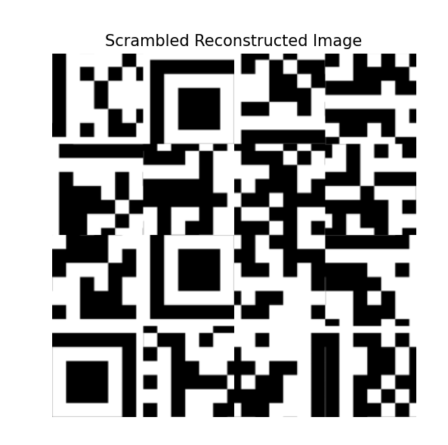
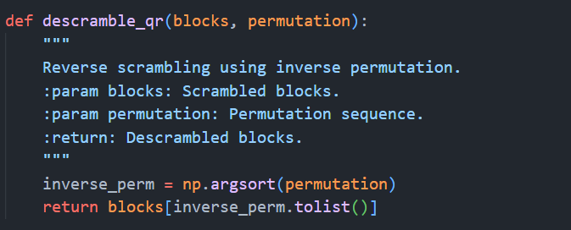
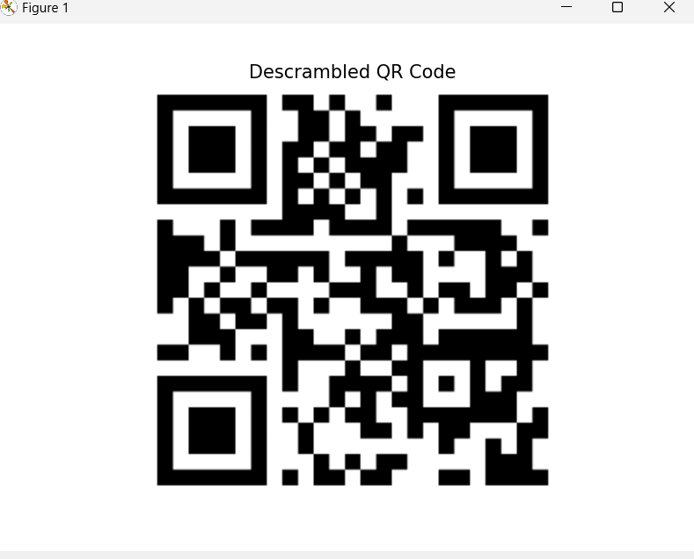
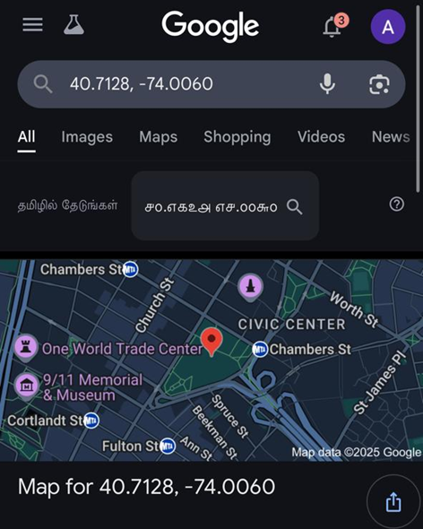
Obtaining scrambled image from AES
Descrambling using LSS and sha256
12

Slide 13
Evaluation metrics
Normalised Cross Correlation
NCORR Measures the similarity between the original and reconstructed QR codes
Peak-Signal-To-Noise Ratio
Measures the difference between the original and reconstructed QR codes in terms of pixel intensity distortion.
Higher PSNR means better quality that means less distortion.
Structural Similarity Index (SSIM)
Compares luminance, contrast, and structure between images.
More sensitive to human visual perception than PSNR.
13

Slide 14
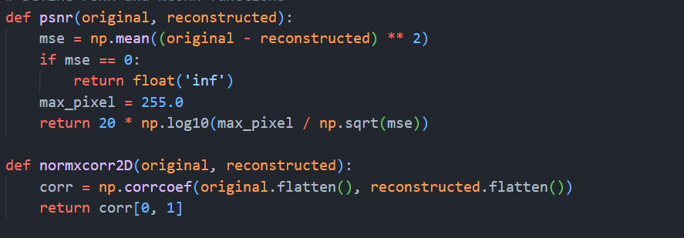
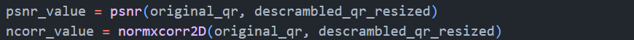

MODULE-3:Evaluvation metrics
14

Slide 15
References
[1] Haroon Rashid ,Hammood Al Dallal and Wijdan Noaman Marzoog Al Mukhtar, “A QR Code Used for Personal Information Based On Multi-Layer Encryption System ”, Int. J. Interact. Mob. Technol., vol. 17, no. 09, pp. pp. 44–56, May 2023.
[2] Okubo, I.; Ono, S.; Kim, H.-W.; Cho, M.; Lee, M.-C. “A Study on the Simple Encryption of QR Codes Using Random Numbers.” Electronics 2024, 13, 3003.
[3] X. Wu, N. An and Z. Xu, "Sharing Multiple Secrets in XOR-Based Visual Cryptography by Non-Monotonic Threshold Property," in IEEE Transactions on Circuits and Systems for Video Technology,
[4] S. Sharma, S. Shivani and N. Saxena, "A Self-Authenticating Multi-Tone Secret Sharing Scheme Using Meaningful Shares for Satellite Images," in IEEE Access, vol. 12, pp. 101563-101591, 2024,
[5] S. Saha, A. K. Chattopadhyay, A. K. Barman, A. Nag and S. Nandi, "Secret Image Sharing Schemes: A Comprehensive Survey," in IEEE Access, vol. 11, pp. 98333-98361, 2023,
15

Slide 16
References
[6] P. Li, J. Ma, L. Yin and Q. Ma, "A Construction Method of (2, 3) Visual Cryptography Scheme," in IEEE Access, vol. 8, pp. 32840-32849, 2020,
[7] A. Jolfaei, X. -W. Wu and V. Muthukkumarasamy, "On the Security of Permutation-Only Image Encryption Schemes," in IEEE Transactions on Information Forensics and Security, vol. 11, no. 2, pp. 235-246, Feb. 2020,
[8] Zhengxin Fu, Liguo Fang, Hangying Huang, Bin Yu,”Distributed three-level QR codes based on visual cryptography scheme,”,Journal of Visual Communication and Image Representation,Volume 87,2022,
[9] Bhardwaj, C., Garg, H., & Shekhar, S. (2022). “:An Approach for Securing QR code using Cryptography and Visual Cryptography.” 2022 International Conference on Computational Intelligence and Sustainable Engineering Solutions (CISES)
[10] Xiaohe Cao, Liuping Feng, Peng Cao and Jianhua Hu “Secure QR Code Scheme Based on Visual Cryptography” 2nd International Conference on Artificial Intelligence and Industrial Engineering (AIIE2016)
16

